Slide 1

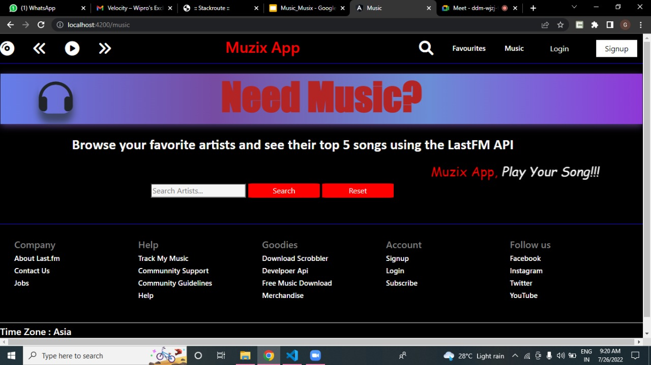

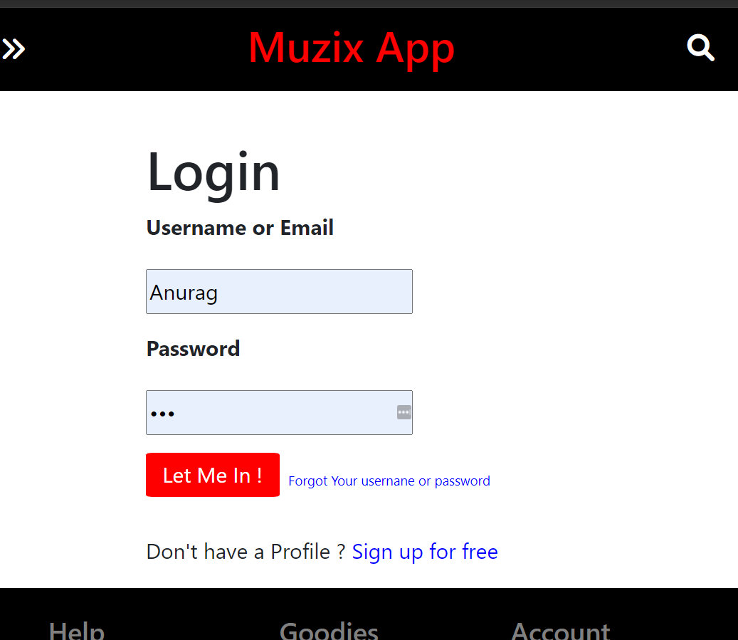
Muzix-App
Batch - 06
Teammate : Gopal Gupta
Anurag Shahi
Dhaneshwar Singh
Under the guidance of :
Santhosh Sir

Slide 2
Outline
Problem Statement
Objective
Project Overview
Microservices
Architecture
Application Flow
Technology and Tools Used
Container
Conclusion

Slide 3

Problem Statement
User can play the tracks.
They can login/register.
We can search music by artist name or song name.
According to his/her choice they can add favorite tracks .

Slide 4
Objective :
Our objective is to build an application to play music according to artist name, album name and we can listen music track and add those tracks to a playlist/favorite list.

Slide 5
Project Overview

Slide 6
Project Overview
Authentication API
Favourite API
Favourite
Login
Recommendation
Home
Register
Search Music
MY SQL
Server
MY SQL
Server
External API

Slide 7

Microservices
Authentication
Services
Recommendation API
Eureka Service
Favourite
Service
API Gateway

Slide 8
Onboarding Architecture

Slide 9
Architecture
Authentication API
JWT validator
MY SQL
Serve
Login/Register
POST,GET, PUT request
Favourite API
Get favourite
POST
GET
MY SQL
Serve
GET
Front End
Angular
GET
API Gateway
MY SQL
Serve
GET
Search Track
based on title/artists
External API
GET
GET

Slide 10
Project Flow

Slide 11
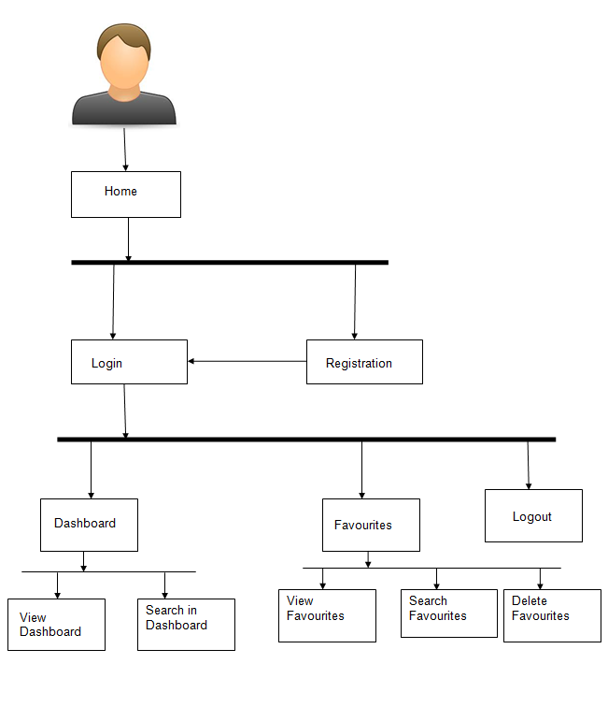
Project Flow
Home
Login
Register
Search
View Track
Favourite
Recommends
Recommendations
View Favourites
Add Favourite
View Recommends
Add to Favourite
Search Books

Slide 12






Technologies and Tools Used

Slide 13
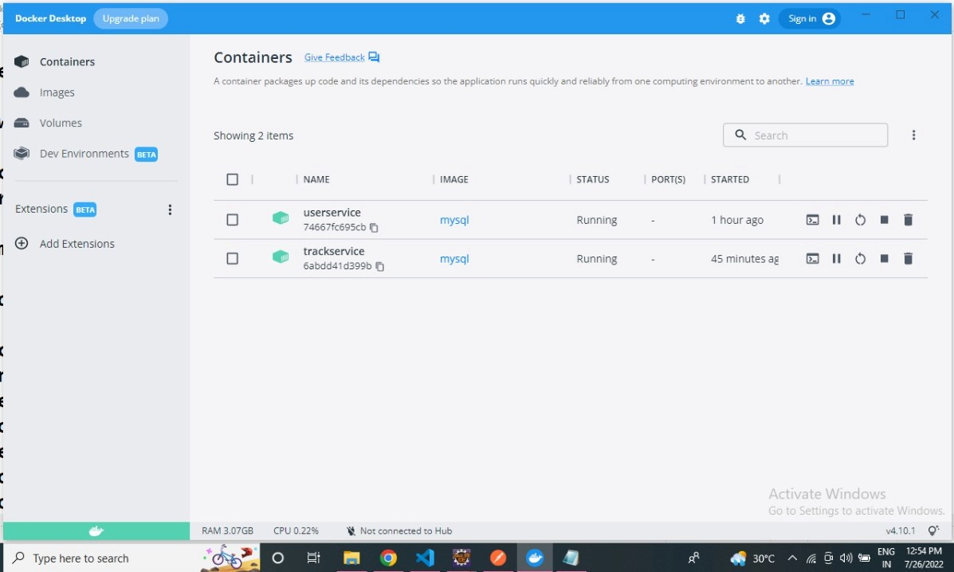
Docker

Slide 14
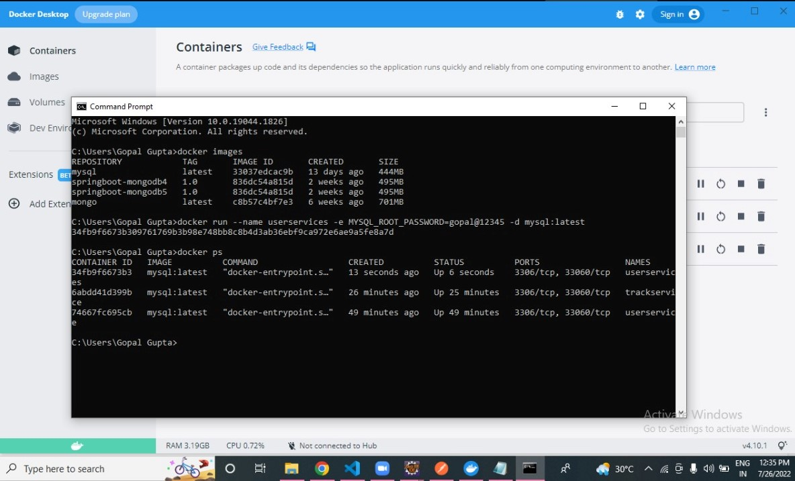

Slide 15
Conclusion:
The Muzix Music App helps the user to listen songs online.
It also helps user to create the favourite music tracks, playlists.
Fill your world with the songs, albums and artists that define you. Get unlimited access to millions of tracks, curated playlists and original content from the artists you know and love.

Slide 16
Thank You

